Slide 1
C/C++ Programming in a UNIX Environment
CS 3377
Bhanu Kapoor, PhD
Department of Computer Science University of Texas, Dallas, TX bhanu.kapoor@utdallas.edu
Notes Week 02

Slide 2
Reading for Week 02
Chapter 1 Unix System Overview from Advanced Programming in the UNIX Environment by Stevens and Rago
Recap Chapters 5-14 from C for Programmers with an Introduction to C++. by Harvey Deitel and Paul Deitel.
All books for the course are available online & free via UTD Library => eBook
=> Safari)

Slide 3
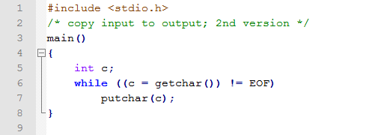
C Program to Copy Files: v2
./a.out < file1 > file2
c = getchar()) != EOF what happens?
c = (getchar()) != EOF) precedence of != higher than =

Slide 4
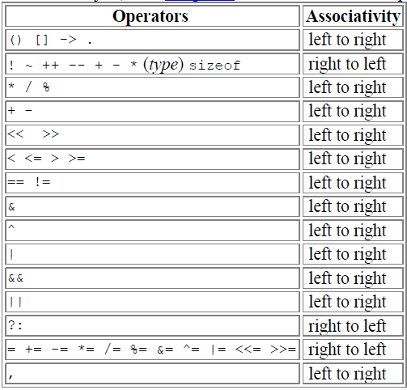
Precedence in C
□ Operators in the same line have same precedence, rows in decreasing precedence

Slide 5
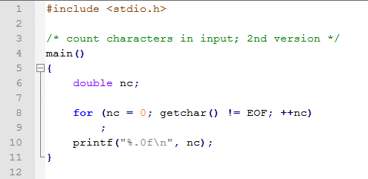
Count Characters
Only difference is the inclusion of nc variable – why double type?
What’s in the body of for loop?
What does print formatting do here?
What effect does ++nc have on nc?

Slide 6
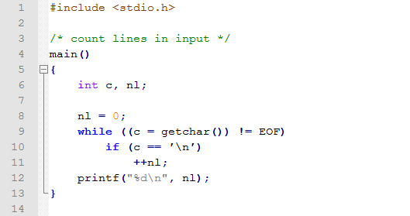
Line Counting
□ What’s are the difference from the previous
program?
□ What would you do if you have to counts words in a file?

Slide 7
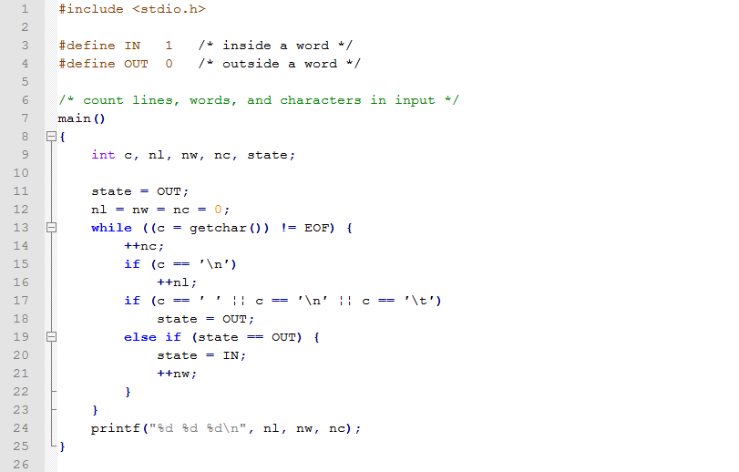
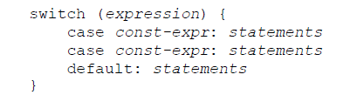
Counting Words
Can also be written as

Slide 8
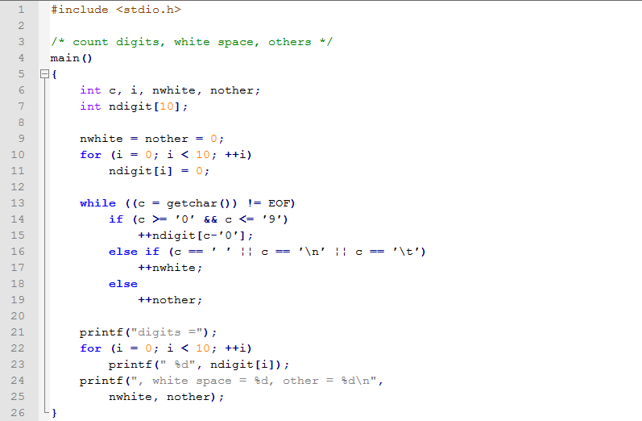
Arrays: Counting Digits & more
?

Slide 9
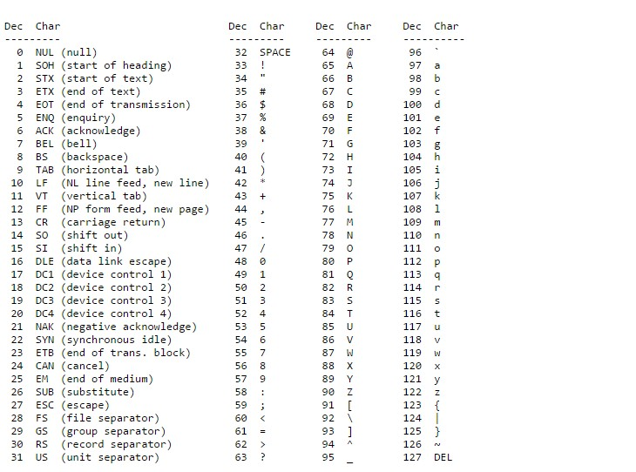
ASCII Table
char c = 'B'+32; What would this evaluate to?

Slide 10
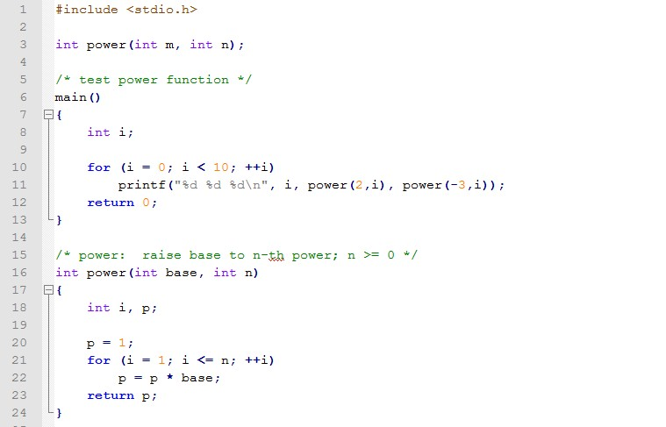
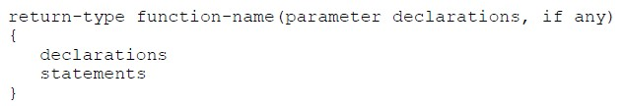
Functions in C
?
Function Syntax

Slide 11
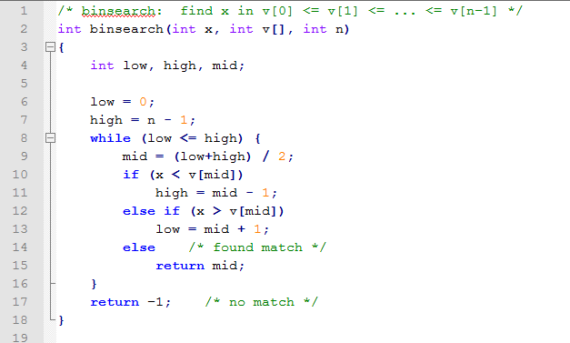
Binary Search
What are the parameters in this function?
Parameters versus arguments
What is this function doing?

Slide 12
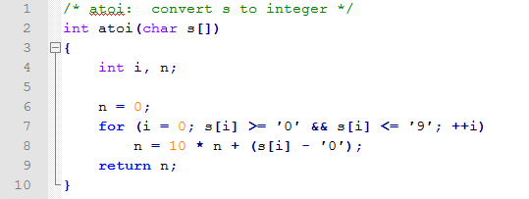
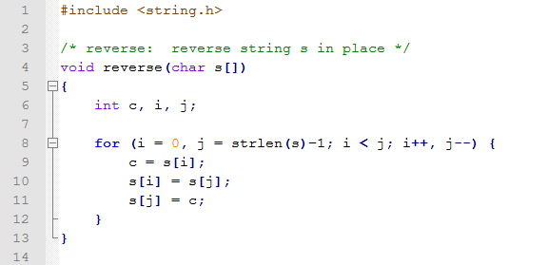
More Functions
Comma Operator

Slide 13
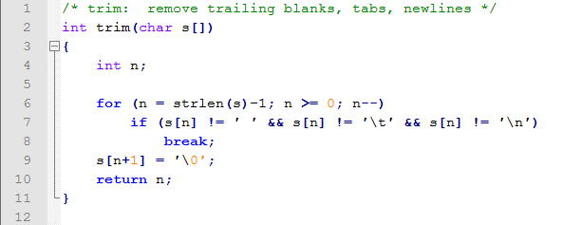
Break
What is this function doing? How is break being used?
There is also a continue

Slide 14
Various Types Variables in C
Local Variables
Global Variables and extern
Static Variables
Constant Variables

Slide 15
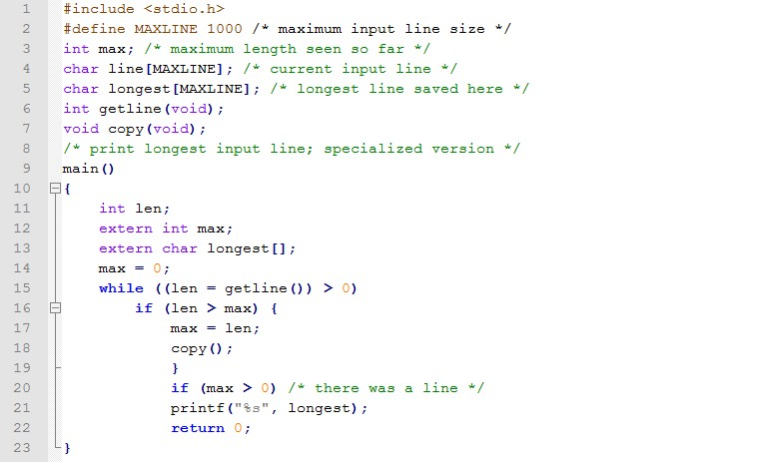
Extern Variables

Slide 16
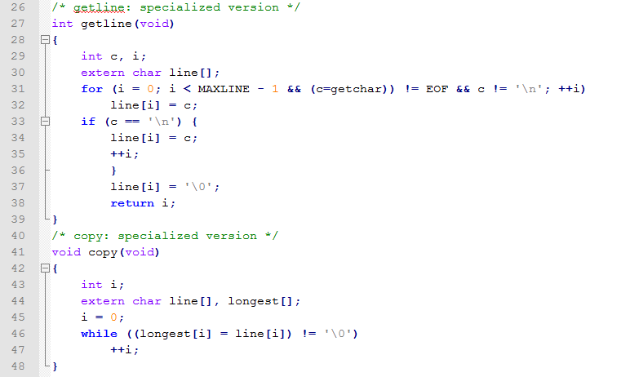
Extern Variables

Slide 17
C Overview
Pointers
Command Line Arguments
File I/O

Slide 18
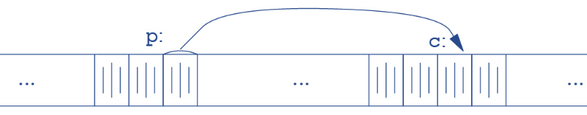
Pointers
□ Pointer: a variable that contains address of a variable
□ The unary operator & gives the address of an object, so the statement
◼ p = &c;

Slide 19
Pointers and Addresses
int x = 1, y = 2, z[10];
int *ip; /* ip is a pointer to int */
ip = &x; y = *ip;
*ip = 0;
ip = &z[0];
/* ip now points to x */
/* y is now 1 */
/* x is now 0 */
/* ip now points to z[0] */
double *dp, atof(char *); ?

Slide 20
Pointers and Addresses
If ip points to the integer x, then *ip can occur in any context where x could, so
*ip = *ip + 10; increments *ip by 10.
The unary operators * and & bind more tightly than arithmetic operators, so the assignment
◼ y = *ip + 1
◼ *ip += 1
◼ ++*ip
(*ip)++ What happens with or without parentheses?

Slide 21
Pointers and Addresses
int *ip;
int *iq;
iq = ip
/* ip is a pointer to int */
/* iq is a pointer to int */

Slide 22
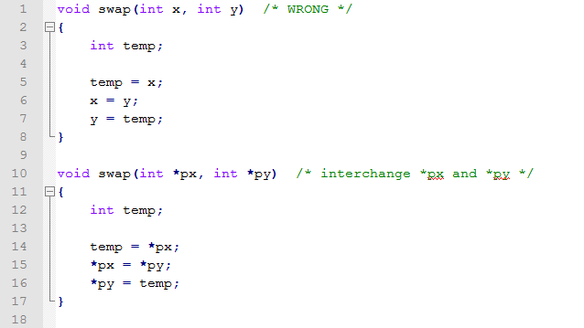
Swap Example
swap(a, b);
swap(&a, &b);

Slide 23
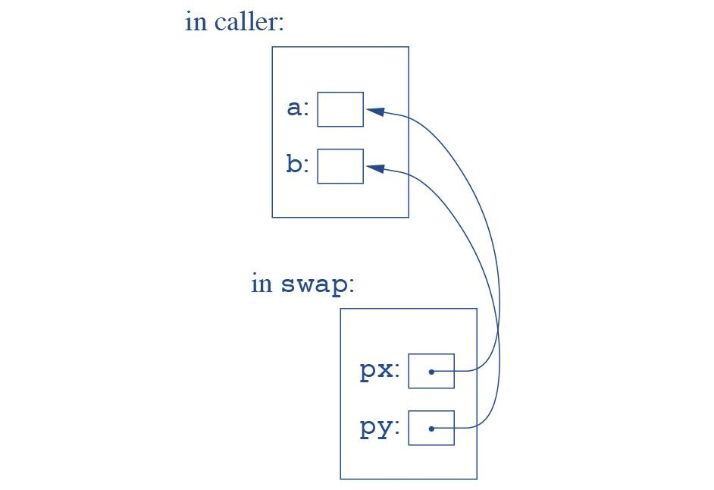
Swap

Slide 24
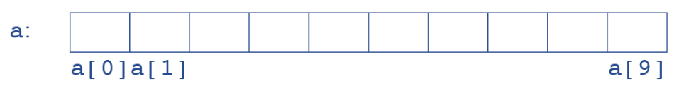
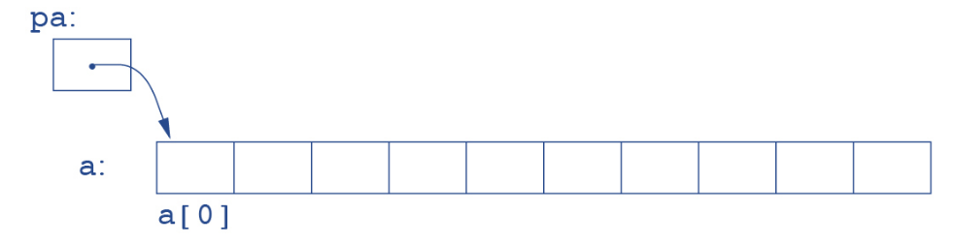
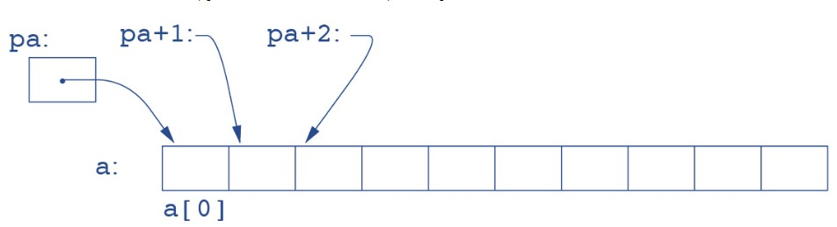
Pointers and Arrays
□ int a[10];
int *pa
pa = &a[0]
x = *pa; ?
pa = &a[0]; or pa = a;
What is *(a+i)?

Slide 25
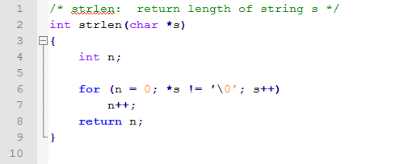
String Length
f(&a[2])
f(int arr[]) { ... }
f(a+2)
or
f(int *arr) { ... }

Slide 26
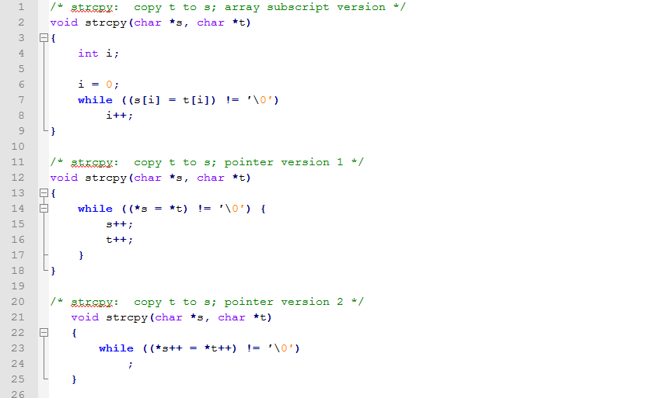
String Copy

Slide 27
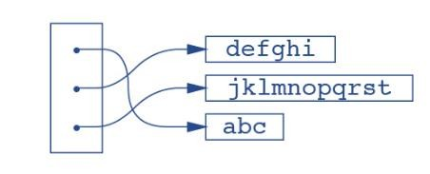
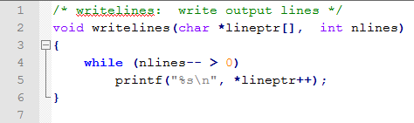
Pointers to Pointers

Slide 28
Multi-dimensional Array
□ mda[i][j] /* [row][col] */
□ f(int mda[2][10]) { ... }
□ f(int mda[][10]) { ... }
□ f(int (*mda)[10]) { ... }

Slide 29
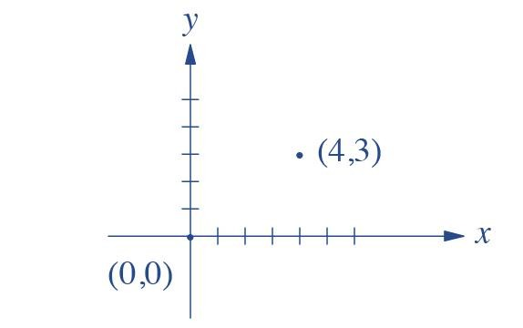
Structures
struct point { int x;
int y;
};
printf("%d,%d", pt.x, pt.y);
dist = sqrt((double)pt.x*pt.x + (double)pt.y*pt.y);
struct point pt;
struct point maxpt = {320, 200};

Slide 30
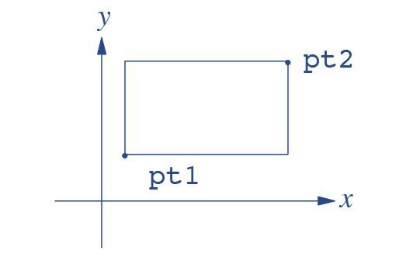
Nested Structures
struct rect {
struct point pt1; struct point pt2;
};
struct rect screen;
screen.pt1.x = 10.0;

Slide 31
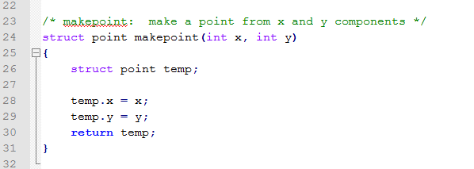
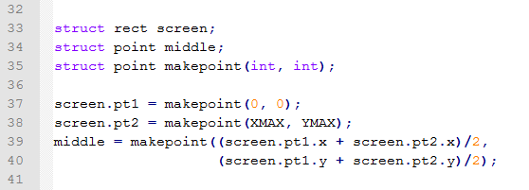
Structures and Functions

Slide 32
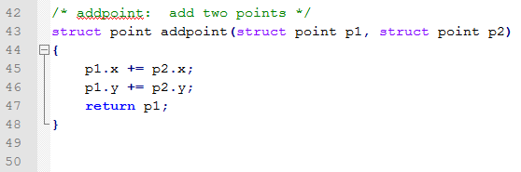
Structures and Functions

Slide 33
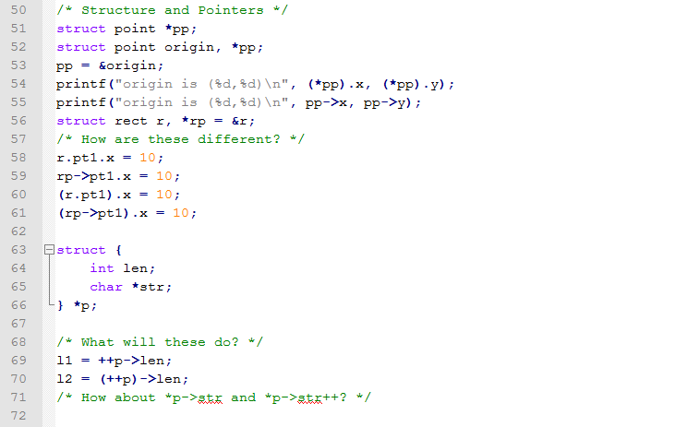
Structures and Pointers

Slide 34
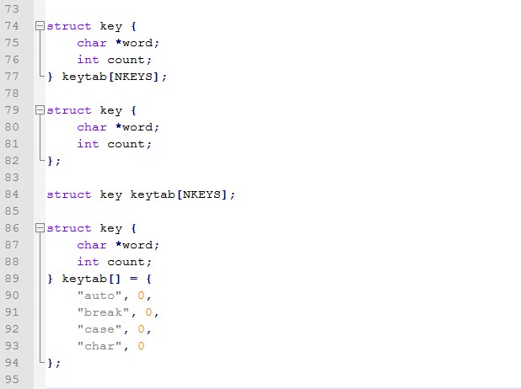
Arrays and Structures

Slide 35
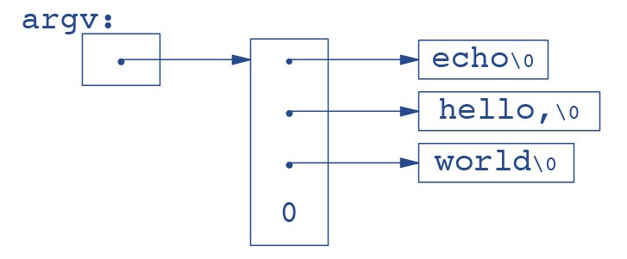
Command Line Arguments
main called with 2 arguments: argc, argv
argc: argument count
argv: argument vector
Unix command: echo hello, world

Slide 36
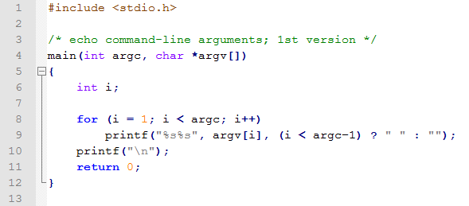
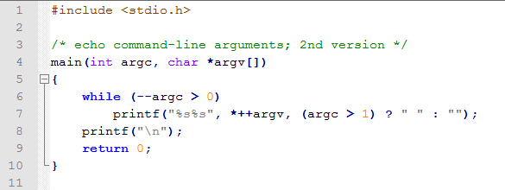
Echo Implementation

Slide 37
Standard IO
int getchar(void)
prog <infile < for input redirection
int putchar(int)
prog >outfile

Slide 38
File Access
cat x.c y.c
Must open a file before you can read
FILE *fp;
FILE *fopen(char *name, char *mode);
fp = fopen(name, mode);
□ mode = “r”, “w”, “a”
For binary files “b” must be appended
int getc(FILE *fp)
int putc(int c, FILE *fp)

Slide 39
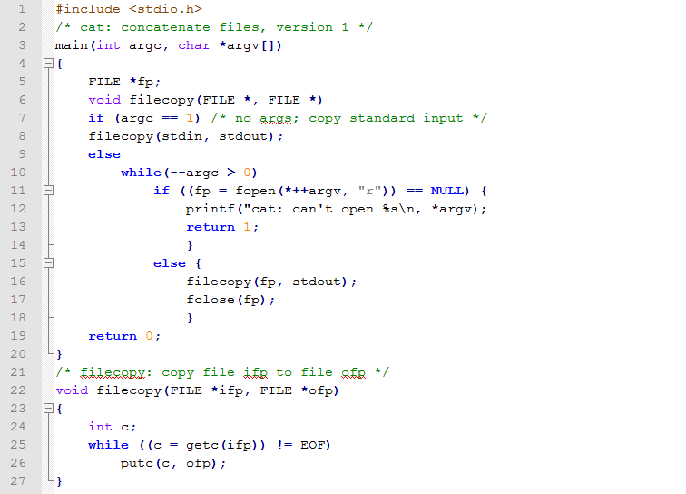
cat

